Slide 1
Antarctic Ozone Enhancement During The 2019 Sudden Stratospheric Warming Event
Sarah Safieddine ⁽¹⁾, Marie Bouillon⁽¹⁾, Ana-Claudia Paracho⁽¹⁾, Julien Jumelet⁽¹⁾, Florent Tencé⁽¹⁾, Andrea Pazmino⁽¹⁾, Florence Goutail⁽¹⁾, Catherine Wespes⁽²⁾, Slimane Bekki⁽¹⁾, Anne Boynard^{(1,3)}, Juliette Hadji-Lazaro⁽¹⁾, Pierre-François Coheur⁽²⁾, Daniel Hurtmans⁽²⁾, and Cathy Clerbaux^{(1,2)}
⁽¹⁾ LATMOS/IPSL, Sorbonne Université, UVSQ, CNRS, Paris, France
⁽²⁾ Université libre de Bruxelles (ULB), Spectroscopy, Quantum Chemistry and Atmospheric Remote Sensing (SQUARES), Brussels, Belgium
⁽³⁾ SPASCIA, Ramonville-Saint-Agne, 31520, France

Slide 2
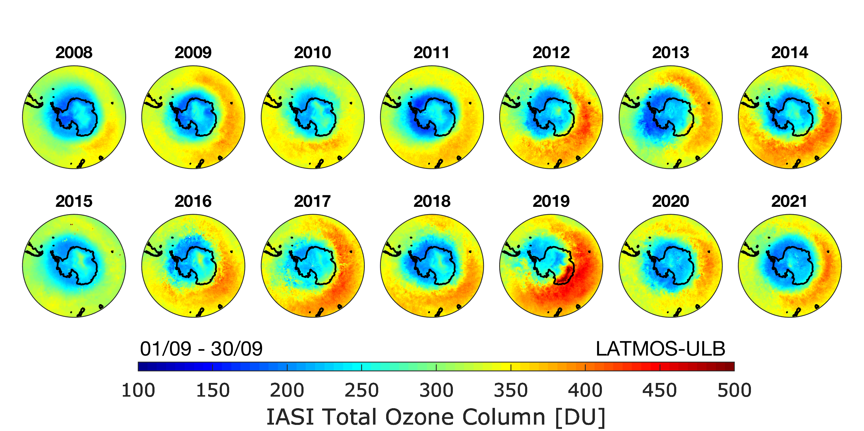
Antarctic ozone from IASI
Courtesy of Anne Boynard (LATMOS)
Courtesy of Anne Boynard (LATMOS)

Slide 3
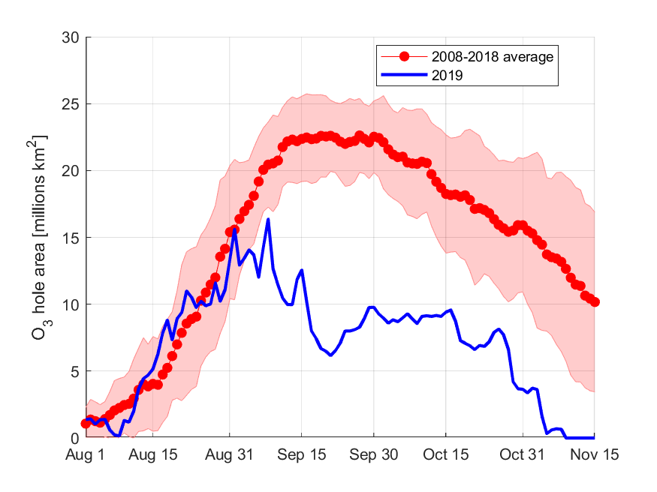
Antarctic ozone from IASI
Ozone hole area in 2019 (in blue) as compared to the mean of 2008-2018 (in red). Shaded areas corresponds to the standard deviation around the mean. Data are retrieved from https://ozonewatch.gsfc.nasa.gov/ and are calculated from measurements of TOMS, OMI, and OMPS.

Slide 4
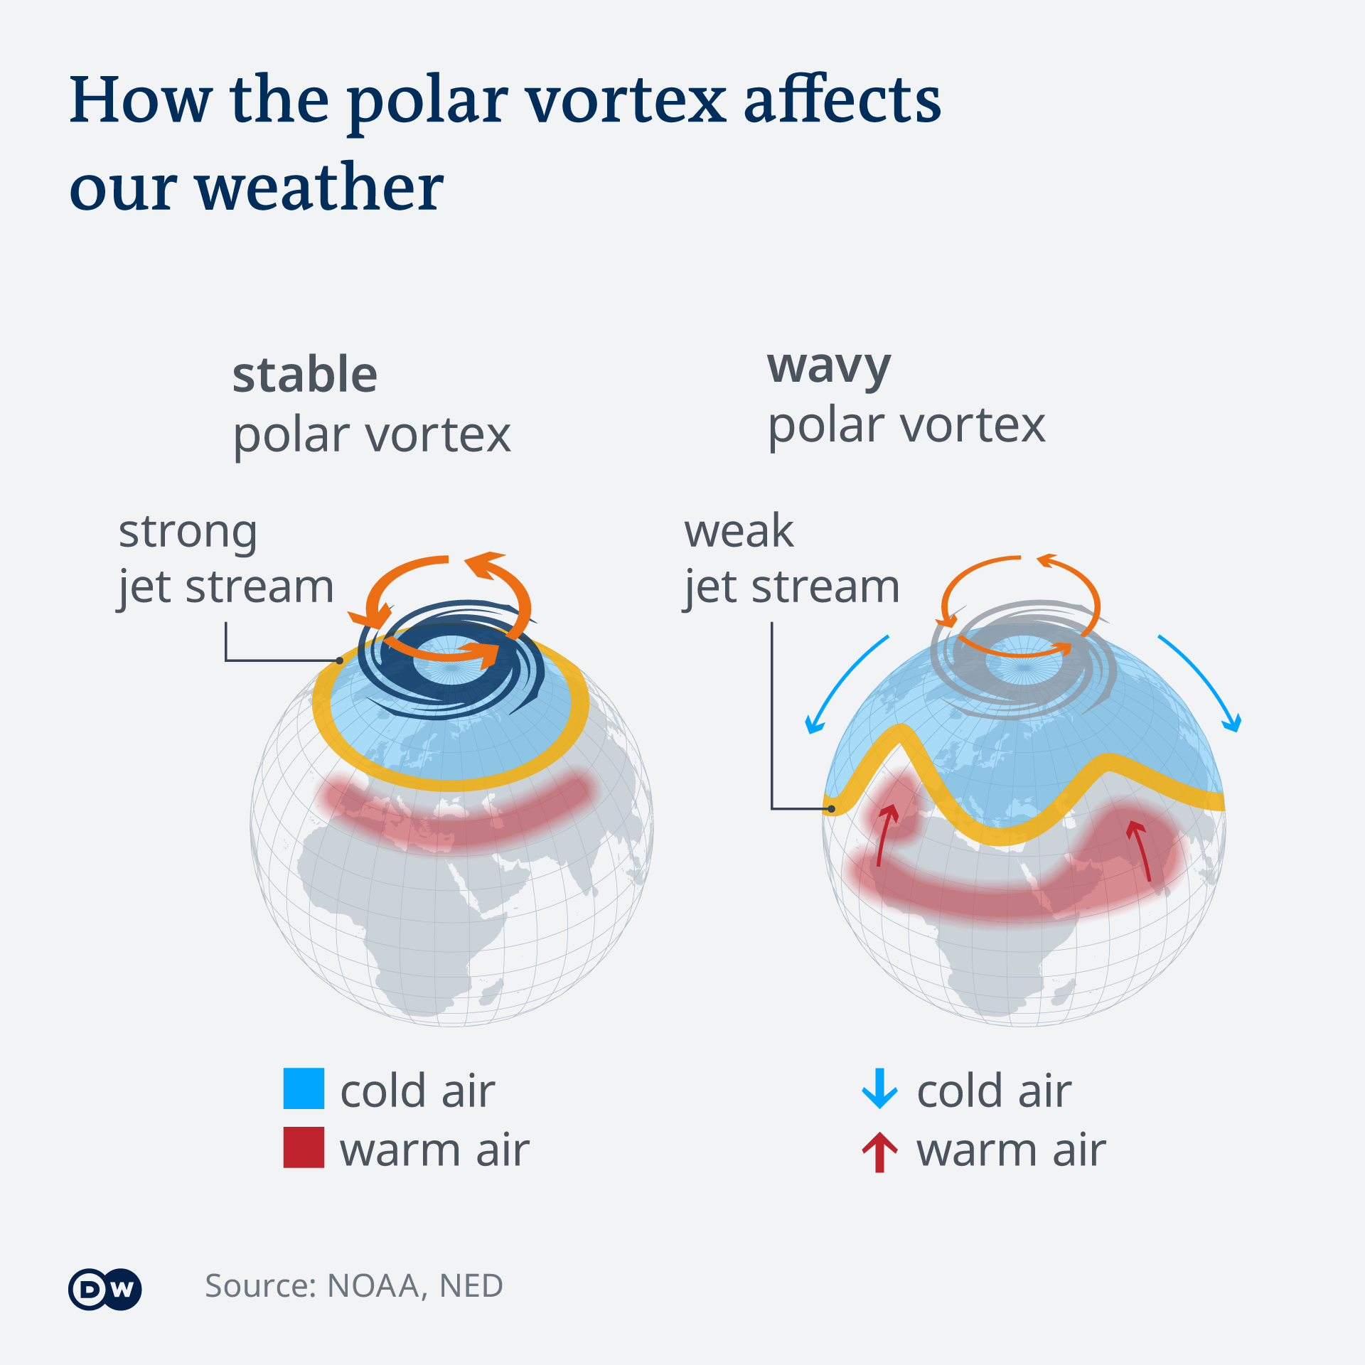
Sudden Stratospheric Warming - SSW (circa 1952): the essentials
Driven by upward travelling planetary waves (Rossby waves) that break the polar jets more frequent in the Northern Hemisphere
The winds in the polar vortex temporarily weaken, or even reverse. The cold air then descends very rapidly in the polar vortex and this causes the temperature in the stratosphere to rise very rapidly, as much as 50­°C over only a few days; hence the term *sudden* stratospheric warming.
Perturbs the weather in the troposphere
Extremely rare in the southern hemisphere due to the stability of the vortex
Only 2 events recorded since the ozone hole discovery: 2002 and 2019

Slide 5
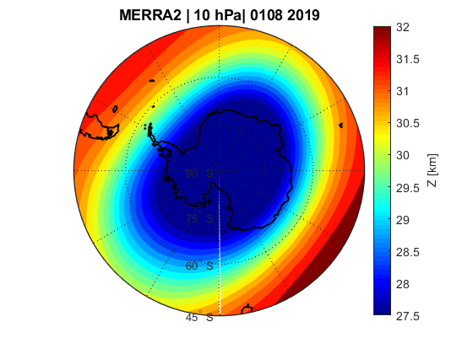
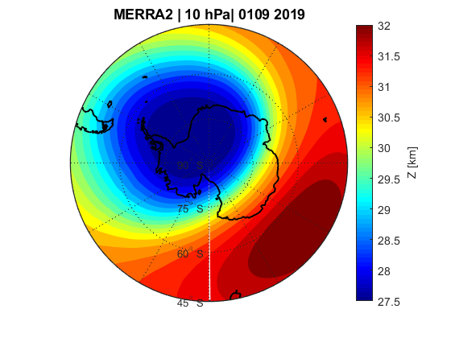
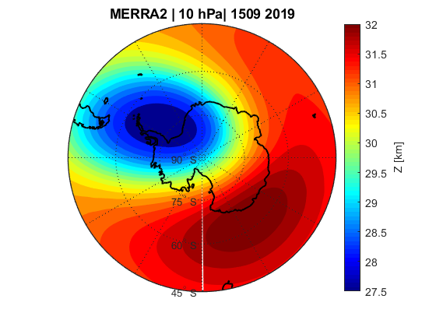
The polar vortex in 2019: the geopotential height* at 10hPa
*expresses the horizontal pressure gradient force as the gradient of the Earth’s gravity field potential (aka geopotential) along a constant-pressure surface

Slide 6
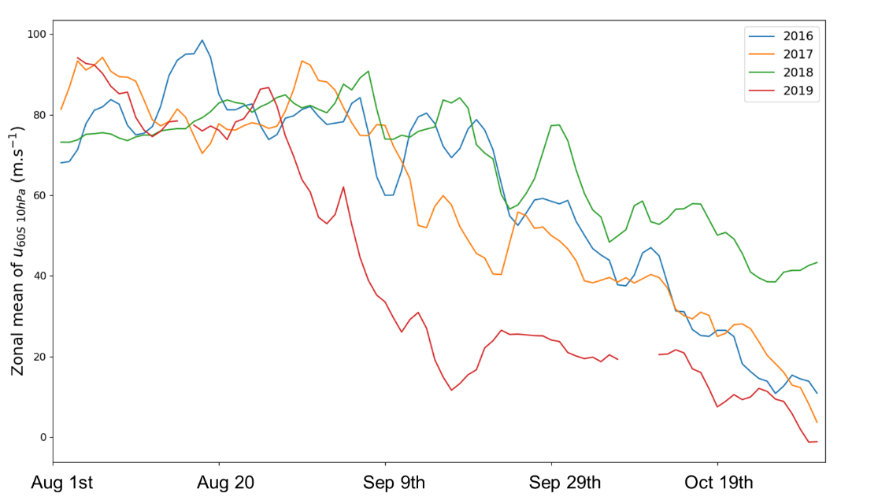
The polar vortex in 2019: the geopotential height* at 10hPa
*expresses the horizontal pressure gradient force as the gradient of the Earth’s gravity field potential (aka geopotential) along a constant-pressure surface
Mean zonal u-wind component over 60°S derived from MERRA-2

Slide 7
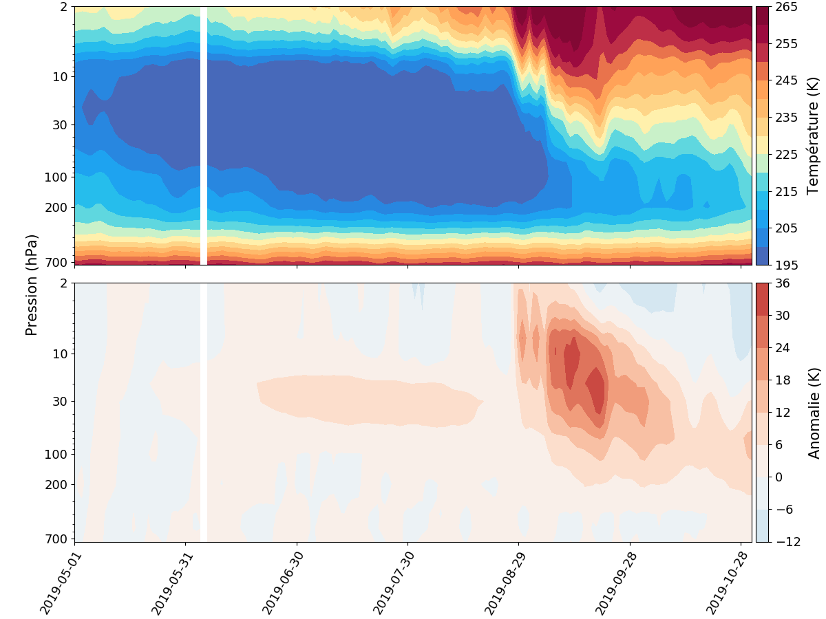
The sudden effect on temperature
Temperature [K]
Pressure
Anomaly

Slide 8
The sudden effect on temperature
Temperature [K]
Pressure
Anomaly

Slide 9
The sudden effect on temperature
Temperature [K]
Pressure
Anomaly

Slide 10
The sudden effect on temperature
Temperature [K]
Pressure
Anomaly

Slide 11
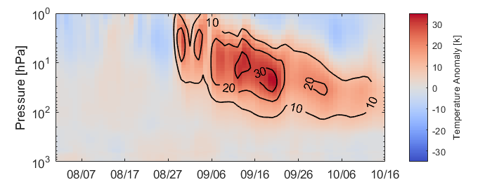
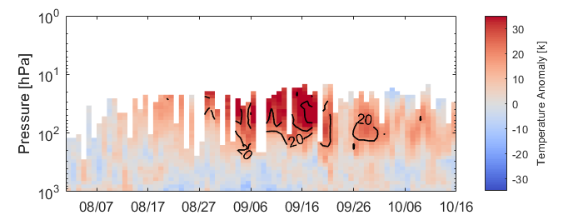
Temperature anomaly also recorded at the Dumont d’Urville station
IASI [60 90]ºS
Dumont d’Urville
30
40

Slide 12
At the Dumont d’Urville station
Polar Stratospheric cloud formation?

Slide 13
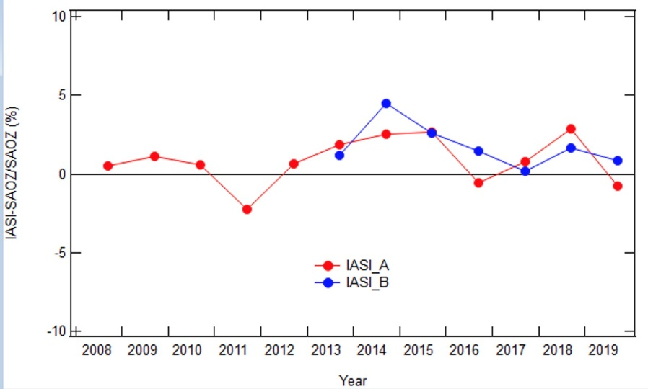
At the Dumont d’Urville station
Polar Stratospheric cloud formation?

Slide 14
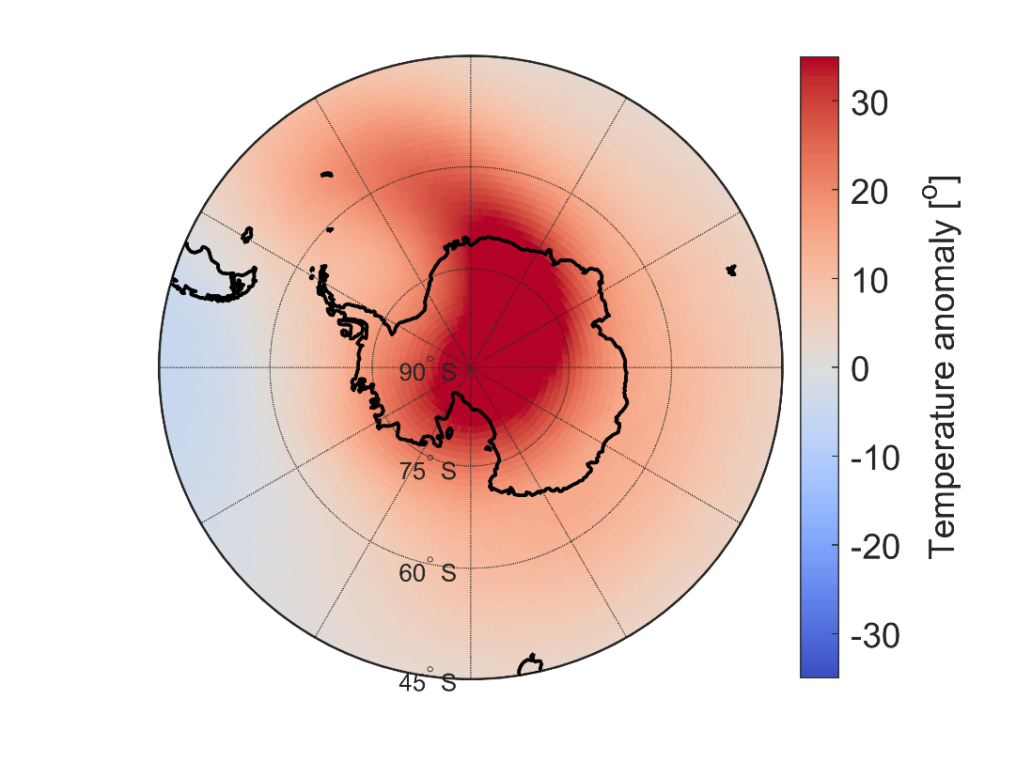
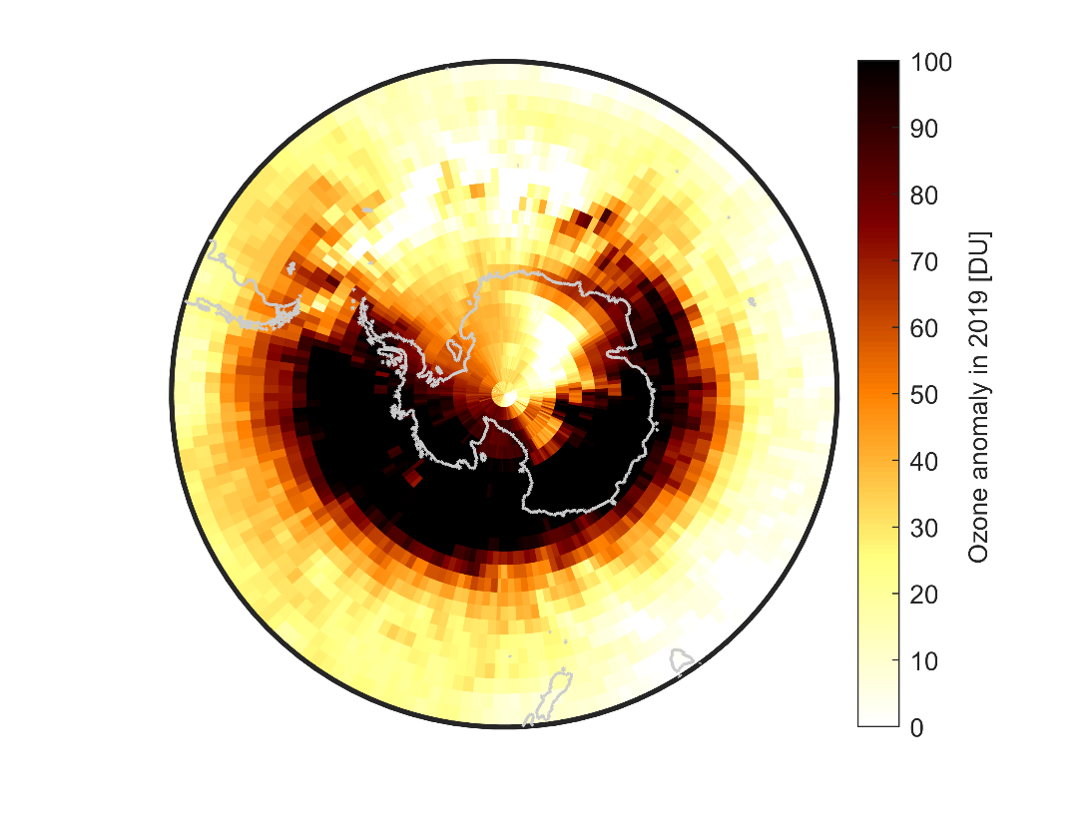
Effect on ozone total columns
Safieddine et al. (2020)

Slide 15
This dramatic fluctuation in the stratosphere alters the weather in the lower atmosphere by affecting the southern hemisphere jet stream. This results in drier conditions over Australia that exacerbated the Australian fires.
Lim et al. (2019)
Anomalous Australian climate conditions during the nine polar vortex weakening years

Slide 16
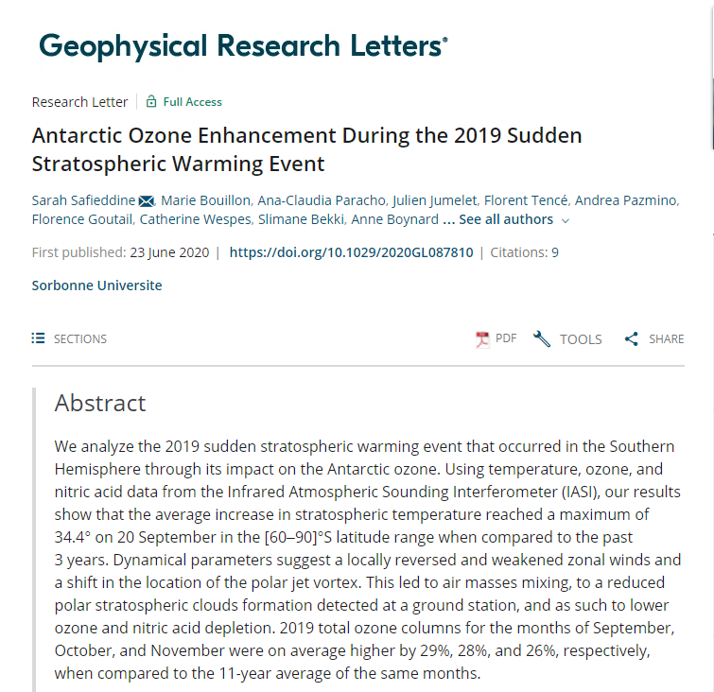
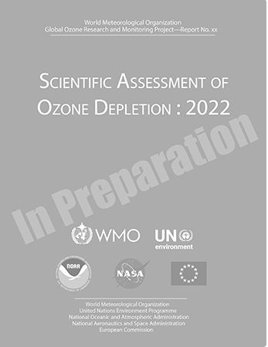
Conclusions
SSW are exceptionally rare in the Southern Hemisphere
In 2019, special meteorological and dynamical conditions led to a weakening of the polar vortex and to a sudden increase in stratospheric temperatures
This led to less PSC formation and as such a lower destruction rates of ozone by heterogeneous chemistry
This does not indicate that the ozone hole has recovered
https://iasi.aeris-data.fr/

